Slide 1
HST 103: History of Bangladesh
Topic – 7: Famines in Bengal

Slide 2
The Bengal Famine of 1943
During World War II, the Bengal Famine of 1943 was human-caused (anthropogenic) in the Bengal province, present-day Bangladesh, West Bengal, and eastern India
An estimated 0.8–3.8 million people died, in the Bengal region- Bangladesh and West Bengal, from starvation, malaria and other diseases aggravated by malnutrition, population displacement, unsanitary conditions, and lack of health care
Millions were impoverished - crisis overwhelmed large segments of the economy and catastrophically disrupted the social fabric
Families disintegrated - men sold their small farms and left home to look for work or to join the British Indian Army, and women and children became homeless migrants, often traveling to Calcutta or other large cities in search of organized relief
“Entitlement Failure” (Amartya Sen’s theory) – failure of people’s access to food and other essentials due to loss of income, unemployment or disruptions in food distribution system

Slide 3
Immediate Causes
Japanese invasion of Burma
Destruction of transport system
Food hoarding and Price hiking
1942–1945: Military build-up, inflation, and displacement
March 1942: Denial policies – “Confiscation/reserve of rice" as well as “Boat Denial” and “Scorched Earth” policies were carried out by the British Government in several southern districts that were expected to have surpluses of rice
Provincial trade barriers – Punjab banned exports of wheat, the Central Provinces prohibited the export of foodgrains, and Madras banned rice exports, followed by export bans in Bengal and its neighboring provinces of Bihar and Orissa

Slide 4

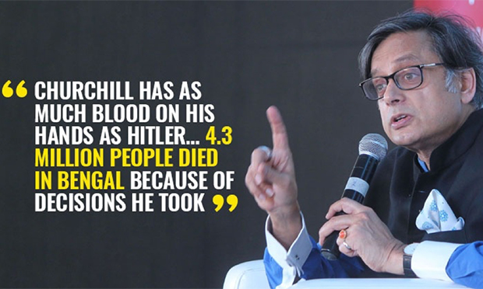

Slide 5
Impact
Death of millions, suffering and displacement of numerous people
Long lasting trauma in the people’s mindset
Collapse of the agricultural system in Bengal
Long term demographic and social effects leading to farther suffering
(reminds us of the movie “Ashoni Sonket” by Satyajit Ray, which is based on Bibhutibhushan Bandyapadhaya’s novel of the same name)

Slide 6
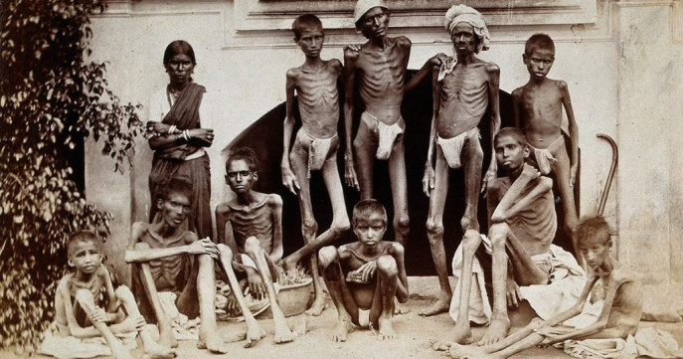
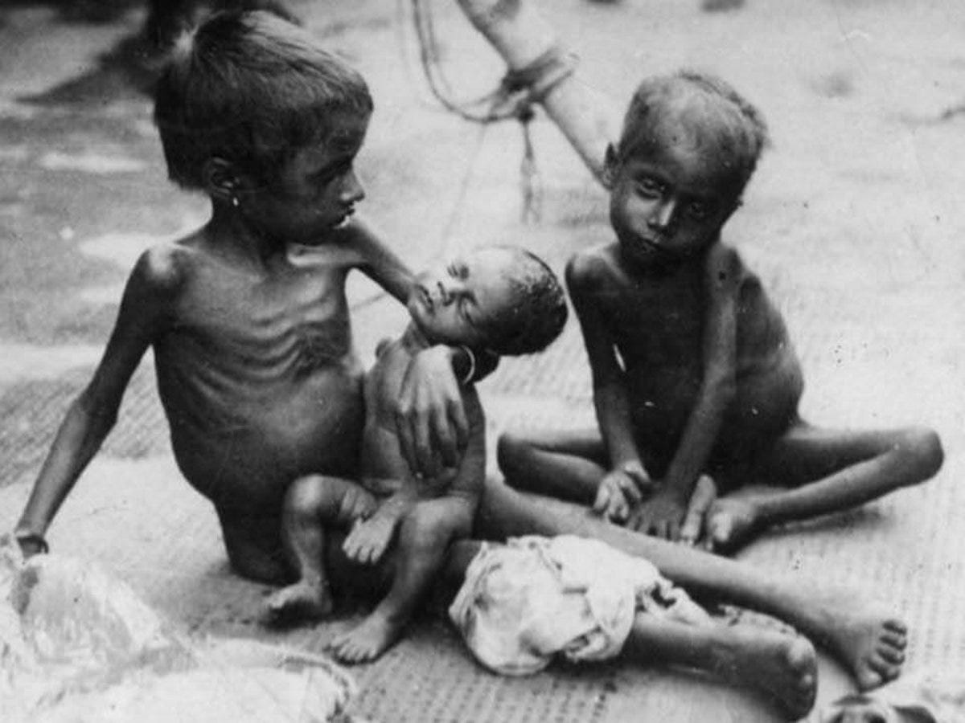
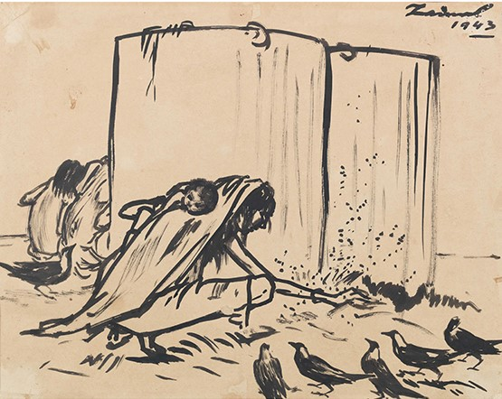
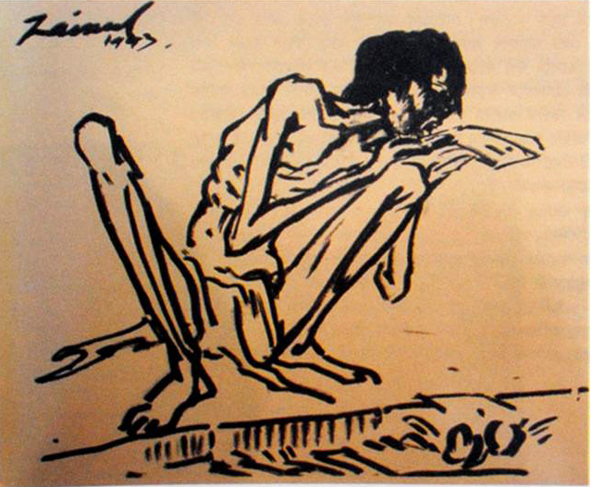

Slide 7
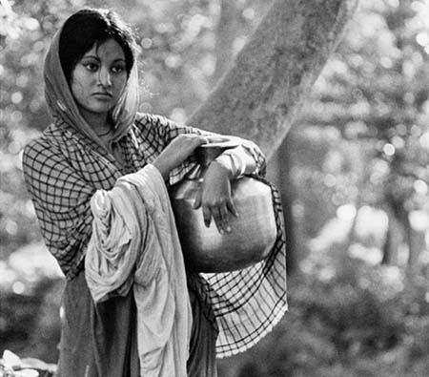

“Ashoni Sanket”, 1973

Slide 8
Bangladesh Famine of 1974
Natural Causes
Floods and Natural Disasters
In July–September 1974, massive floods affected large parts of central and northern Bangladesh. Around 36% of the cultivated land was submerged.
These floods destroyed significant portions of the 'aus' (rice crop harvested in July-August) and damaged 'aman' (rice crop transplanted in July-September) nurseries, leading to a substantial loss in food production. The floods also devastated the jute crop, a major source of income for rural populations.

Slide 9
Administrative Causes
Refugee Crisis and Post-war Devastation: The aftermath of the 1971 Liberation War left infrastructure broken, and millions were displaced or impoverished. The economy was fragile and dependent on foreign aid.
Inadequate Food Stock Management: The government had low public food grain stocks and limited capacity to import food due to acute foreign exchange shortages, exacerbated by the 1973 oil crisis and high international rice prices.
US Food Aid Embargo: The United States withheld food aid to Bangladesh for a year due to Bangladesh's trade with Cuba, significantly impacting the country's ability to cope with the crisis.
Failure of Food Distribution System: Though there was enough food in the country in aggregate, the distribution system was weak and mismanaged. The Public Food Distribution System (PFDS) could not reach the affected areas effectively.
Flawed Rationing System: The existing rationing system primarily benefited urban populations, leaving the rural poor without access to subsidized food.

Slide 10
Administrative Causes contd.
Price Inflation and Hoarding: High inflation partly due to OPEC oil price crisis and then flood-related disruptions and panic, rice prices skyrocketed. Traders and middlemen hoarded food, worsening market availability. By mid-1974, the price of rice more than doubled in many areas.
Smuggling: Food grains were smuggled to neighboring countries, further reducing domestic supply.
Ineffective Relief Efforts: Food aid was often used for budget support and public sector wages rather than direct famine relief.
Weak Governance and Corruption: The new government, led by Sheikh Mujibur Rahman, struggled to manage the crisis efficiently. Corruption and inefficiency in local administration delayed relief efforts. Bureaucratic delays in importing food also worsened the crisis.

Slide 11
Consequences
The immediate and devastating consequences of the famine included:
Human Casualties: Estimated death toll 1.5 million people, primarily due to starvation and disease. The most affected were rural landless laborers and poor urban families.
Disproportionate Impact on the Poor: Wage laborers, non-landowners, and the rural poor were the most severely affected, experiencing the highest mortality rates.
Political Instability and Loss of Legitimacy: The famine severely eroded public trust and caused a crisis of legitimacy for the then-ruling Awami League government. This discontent contributed to the political violence and military takeovers that followed in the subsequent years.
Social and Psychological Trauma: The collective experience of the famine left deep social and psychological scars on the population, particularly in the hardest-hit regions.

Slide 12
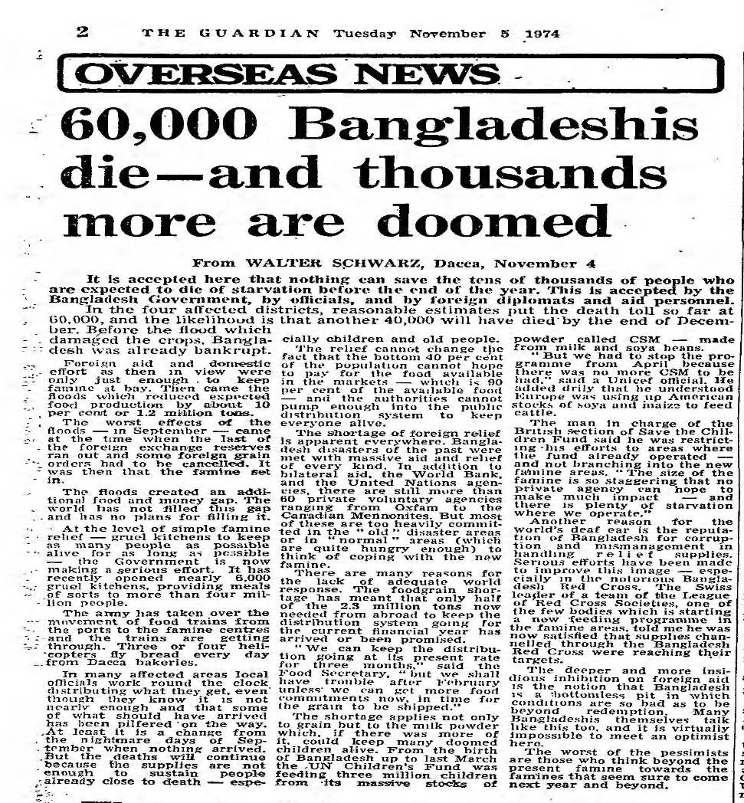
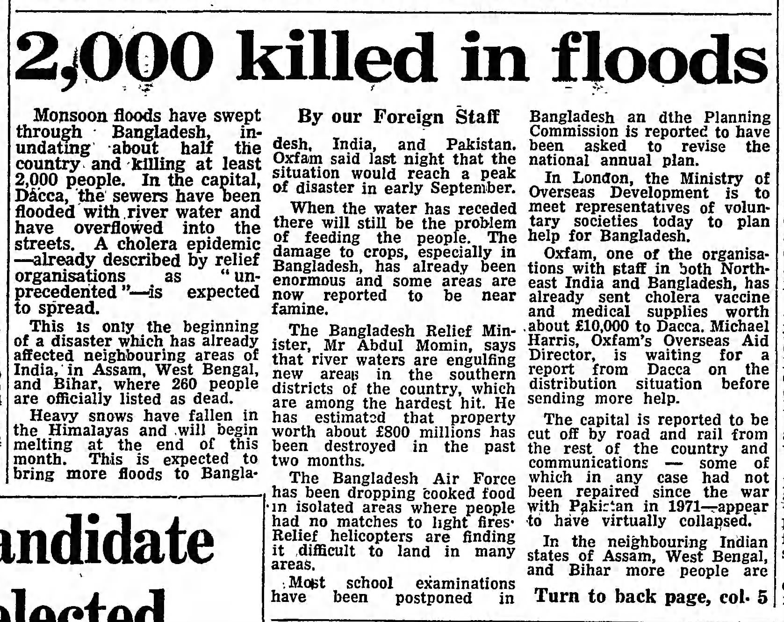
Famine of 1974

Slide 13
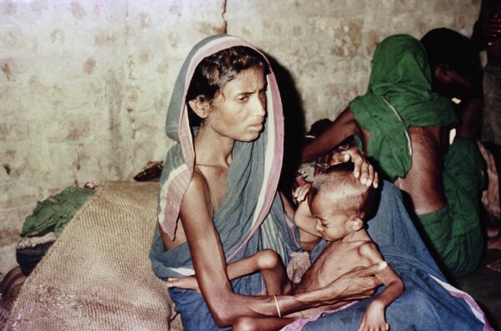
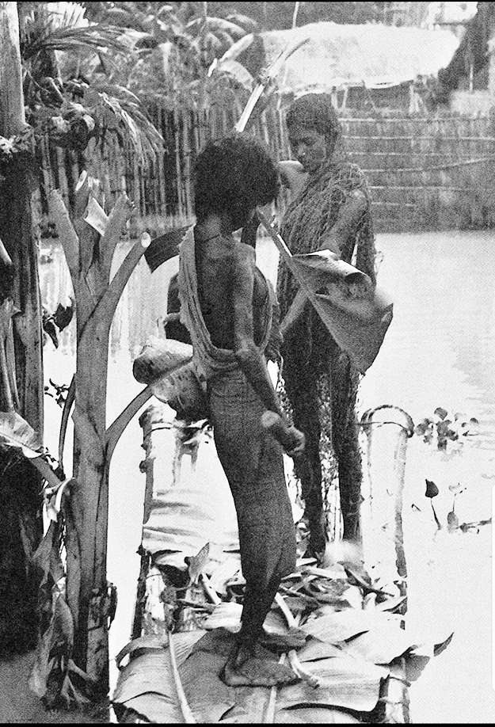
Famine of 1974

Slide 14
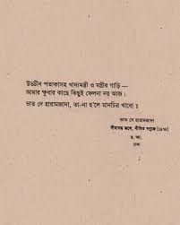
ভীষণ ক্ষুধার্ত আছিঃ উদরে, শরীরবৃত্ত ব্যেপে অনুভূত হতে থাকে- প্রতিপলে- সর্বগ্রাসী ক্ষুধা অনাবৃষ্টি- যেমন চৈত্রের শষ্যক্ষেত্রে- জ্বেলে দ্যায় প্রভুত দাহন- তেমনি ক্ষুধার জ্বালা, জ্বলে দেহ দু’বেলা দু’মুঠো পেলে মোটে নেই অন্য কোন দাবী অনেকে অনেক কিছু চেয়ে নিচ্ছে, সকলেই চায়ঃ বাড়ি, গাড়ি, টাকা কড়ি- কারো বা খ্যাতির লোভ আছে আমার সামান্য দাবী পুড়ে যাচ্ছে পেটের প্রান্তর- ভাত চাই- এই চাওয়া সরাসরি- ঠান্ডা বা গরম সরু বা দারুণ মোটা রেশনের লাল চাল হ’লে কোনো ক্ষতি নেই- মাটির শানকি ভর্তি ভাত চাই
------------------------------------------- ----------------------------- ------------ উড্ডীন পতাকাসহ খাদ্যমন্ত্রী ও মন্ত্রীর গাড়ী আমার ক্ষুধার কাছে কিছুই ফেলনা নয় আজ ভাত দে হারামজাদা, তা না হলে মানচিত্র খাবো। ***কবি রফিক আজাদ

